Slide 1
Database Normalization

Slide 2
What is Normalization
Normalization allows us to organize data so that it:
  Allows faster access (dependencies make sense)
  Reduced space (less redundancy)

Slide 3
Normal Forms
Normalization is done through changing or transforming data into various Normal Forms.
There are 5 Normal Forms but we almost never use 4NF or 5NF.
We will only be concerned with 1NF, 2NF, and 3NF.

Slide 4
For a database to be in a normal form, it must meet all requirements of the previous forms:
  Eg. For a database to be in 2NF, it must already be in 1NF. For a database to be in 3NF, it must already be in 1NF and 2NF.

Slide 5
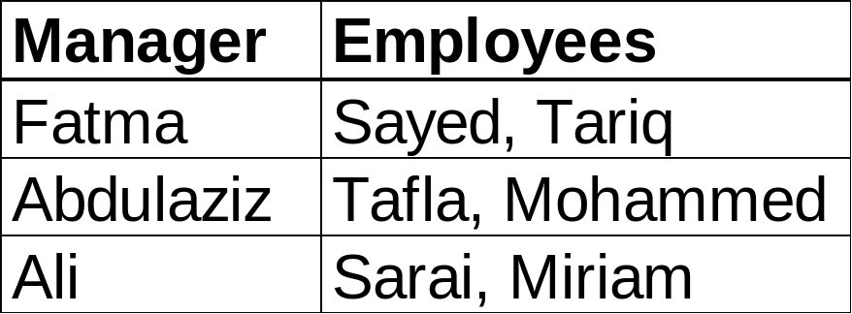
Sample Data
This data has some problems:
  The Employees column is not atomic.
    A column must be atomic, meaning that it can only hold a single item of data. This column holds more than one employee name.

Slide 6
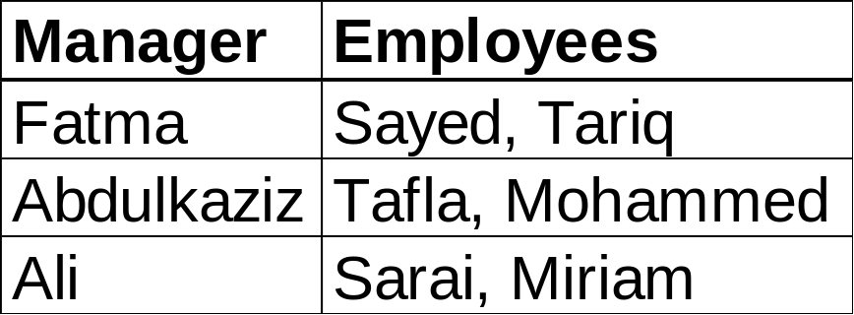
Data that is not atomic means:
  We can’t easily sort the data
  We can’t easily search or index the data
  We can’t easily change the data
  We can’t easily reference the data in other tables

Slide 7
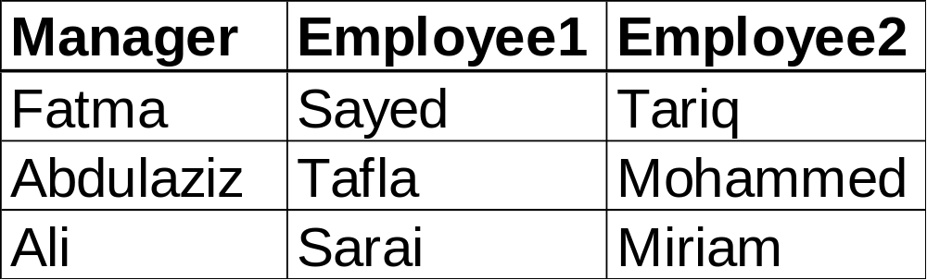
Breaking the Employee column into more than 1 column doesn’t solve our problems:
  The data may look atomic, but only because we have many identical columns storing a single piece of data instead of a single column storing many pieces of data.

Slide 8
  We still can’t easily sort, search, or index our employees.
  What if a manager has more than 2 employees, 10 employees, 100 employees? We’d need to add columns to our database just for these cases.
  It is still hard to reference our employees in other tables.

Slide 9

By the way, what would be a good choice of a Primary Key for this table?
Notes:
Students would be expected to answer “Manager” since each manager is only listed once, and the employees are scattered across multiple columns. Also, an employee may change managers fairly frequently (but once a person is a manager, they are likely to remain managers).

Slide 10
First Normal Form
1NF means that we must:
  Eliminate duplicate columns from the same table, and
Let’s get started by making our columns atomic…
Notes:
Objective: to remove a table’s repeating groups and ensure that all entries of the resulting table have at most a single value.

Slide 11
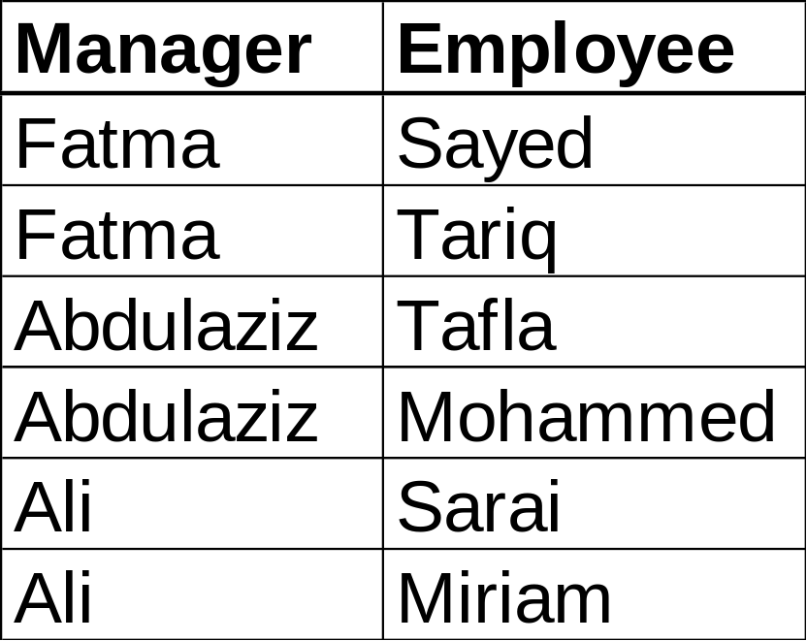
Atomic Data
By breaking each tuple of our table into an entry for each employee, we have made our data atomic.
What would be the primary key?
Notes:
Students should now say that the Employee is the Primary Key since there are now multiple manager values in the table. Only Employee is unique.

Slide 12
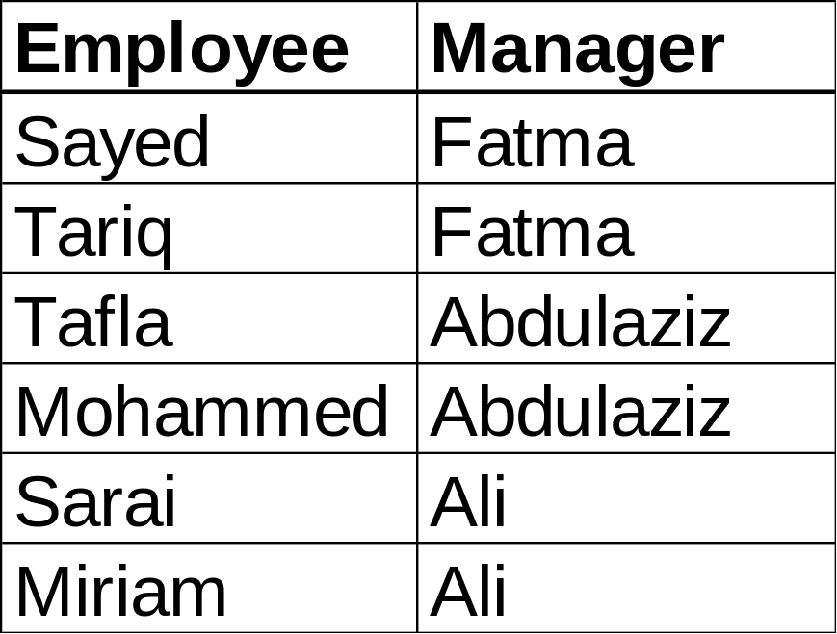
Primary Key
The best primary key would be the Employee column.
Every employee only has one manager, therefore an employee is unique.
Notes:
Students should now say that the Employee is the Primary Key since there are now multiple manager values in the table. Only Employee is unique.

Slide 13
First Normal Form
Congratulations!
The fact that all our data and columns is atomic and we have a primary key means that we are in 1NF!
Notes:
Students should now say that the Employee is the Primary Key since there are now multiple manager values in the table. Only Employee is unique.

Slide 14
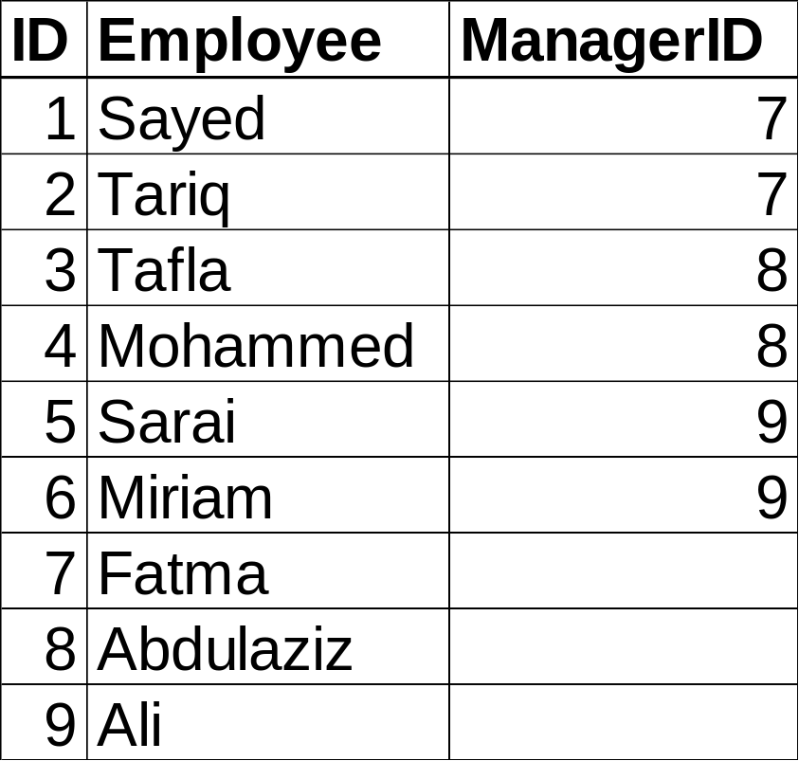
First Normal Form Revised
Of course there may come a day when we hire a second employee or manager with the same name. To avoid this, let’s use an employee ID instead of their name.
Notes:
Students should now say that the Employee is the Primary Key since there are now multiple manager values in the table. Only Employee is unique.

Slide 15

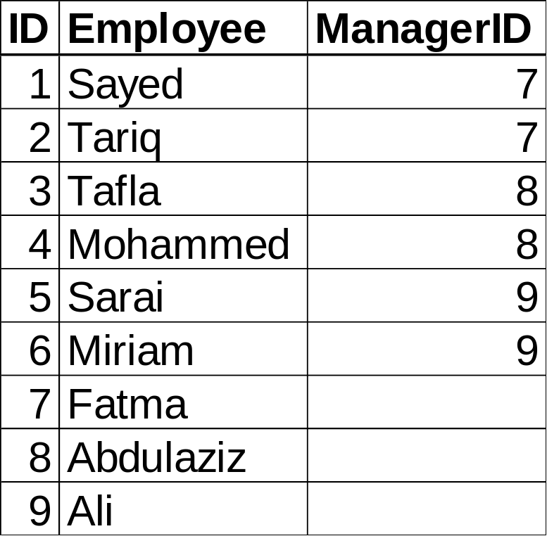
1NF: Before and After

Slide 16
Moving to Second Normal Form
A database in 2NF must also be in 1NF:
  Data must be atomic
  Every row (or tuple) must have a unique primary key
Plus:
  Subsets of data that apply to multiple rows (repeating data) are moved to separate tables

Slide 17
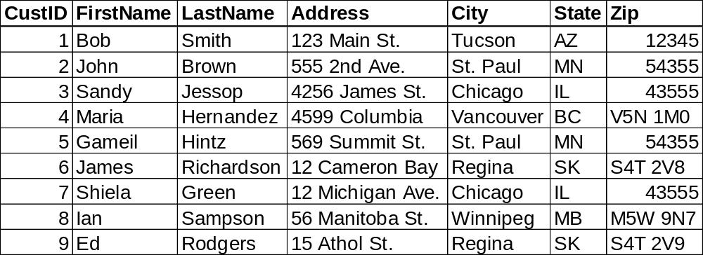
This data is in 1NF: all fields are atomic and the CustID serves as the primary key
Notes:
Students should now say that the Employee is the Primary Key since there are now multiple manager values in the table. Only Employee is unique.

Slide 18
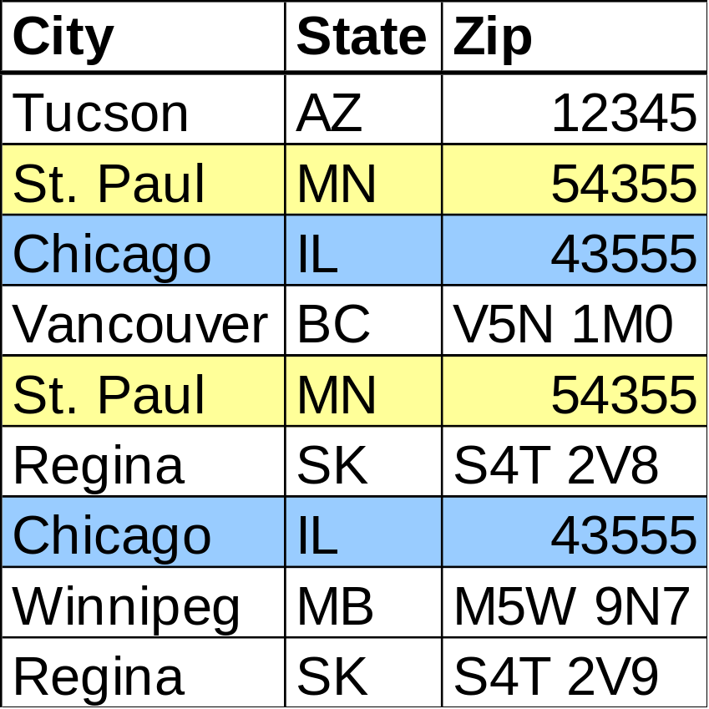
But let’s pay attention to the City, State, and Zip fields:
  There are 2 rows of repeating data: one for Chicago, and one for St. Paul.
  Both have the same city, state and zip code

Slide 19
The CustID determines all the data in the row, but U.S. Zip codes determines the City and State. (eg. A given Zip code can only belong to one city and state so storing Zip codes with a City and State is redundant)
This means that City and State are Functionally Dependent on the value in Zip code and not only the primary key.

Slide 20
To be in 2NF, this repeating data must be in its own table.
So:
  Let’s create a Zip code table that maps Zip codes to their City and State.

Slide 21
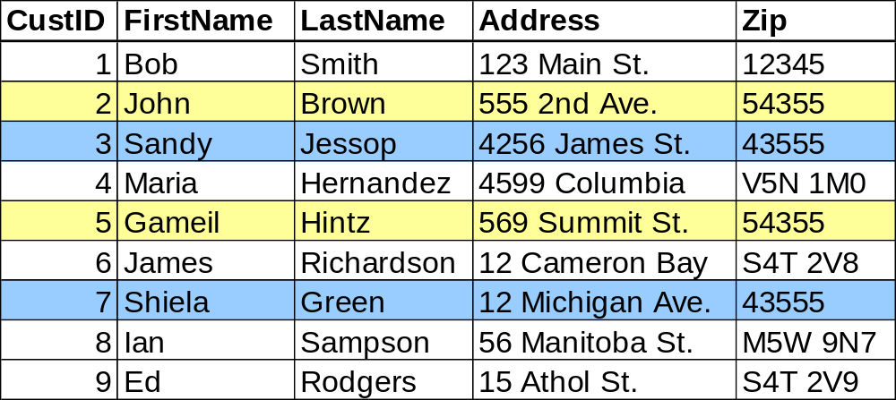
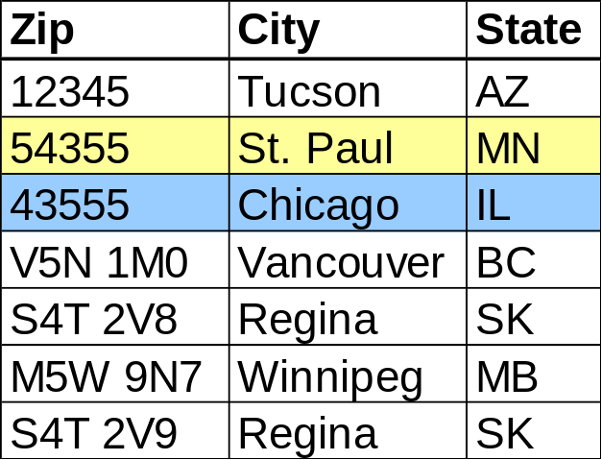
Our Data in 2NF
Customer Table
We see that we can actually save 2 rows in the Zip Code table by removing these redundancies: 9 customer records only need 7 Zip code records.
Zip code becomes a foreign key in the customer table linked to the primary key in the Zip code table
Zip Code Table

Slide 22
Advantages of 2NF
Saves space in the database by reducing redundancies
If a customer calls, you can just ask them for their Zip code and you’ll know their city and state! (No more spelling mistakes)
If a City name changes, we only need to make one change to the database.

Slide 23
Summary So Far…
1NF:
  All data is atomic
  All rows have a unique primary key
2NF:
  Data is in 1NF
  Subsets of data in multiple columns are moved to a new table
  These new tables are related using foreign keys

Slide 24
Moving to 3NF
To be in 3NF, a database must be:
  In 2NF
  All columns must be fully functionally dependent on the primary key (There are no transitive dependencies)

Slide 25
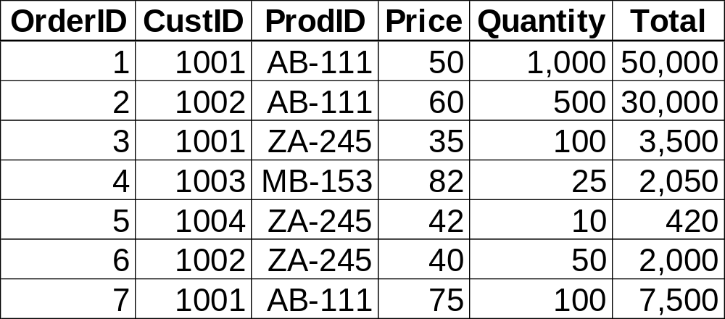
In this table:
  CustomerID and ProdID depend on the OrderID and no other column (good)
  Stated another way, “If you know the OrderID, you know the CustID and the ProdID”
So: OrderID → CustID, ProdID

Slide 26
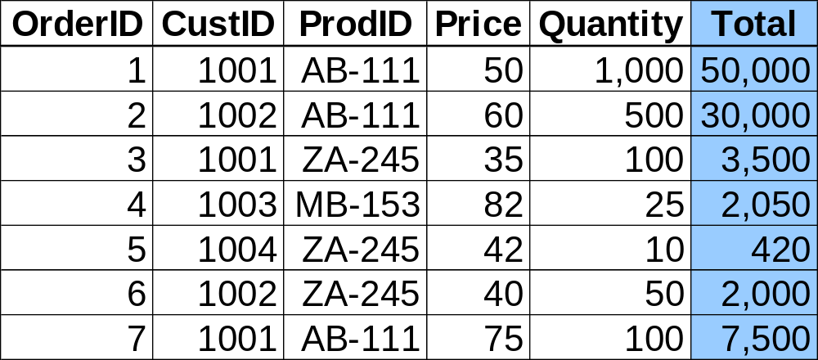
But there are some fields that are not dependent on OrderID:
  Total is the simple product of Price*Quantity. As such, has a transitive dependency to Price and Quantity.
  Because it is a calculated value, doesn’t need to be included at all.

Slide 27
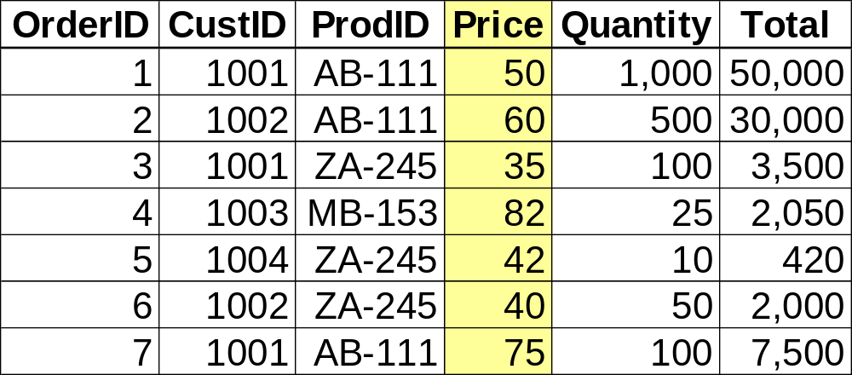
Also, we can see that Price isn’t really dependent on ProdID, or OrderID. Customer 1001 bought AB-111 for $50 (in order 1) and for $75 (in order 7), while 1002 spent $60 for each item in order 2.

Slide 28
Maybe price is dependent on the ProdID and Quantity: The more you buy of a given product the cheaper that product becomes!
So we ask the business manager and she tells us that this is the case.

Slide 29
We say that Price has a transitive dependency on ProdID and Quantity.
  This means that Price isn’t just determined by the OrderID. It is also determined by the size (or quantity) of the order (and of course what is ordered).

Slide 30
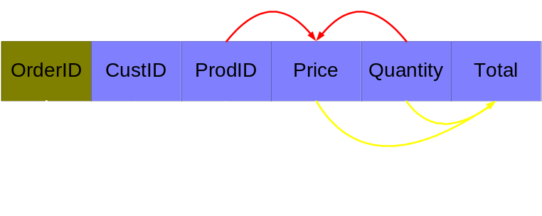
Let’s diagram the dependencies.
We can see that all fields are dependent on OrderID, the Primary Key (white lines)

Slide 31
But Total is also determined by Price and Quantity (yellow lines)
  This is a derived field
  (Price x Quantity = Total)
  We can save a lot of space by getting rid of it altogether and just calculating total when we need it

Slide 32
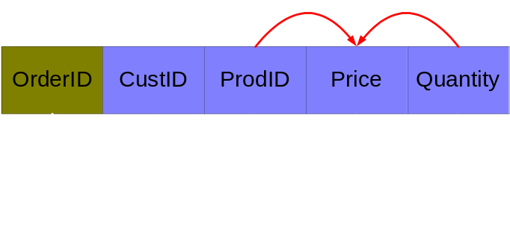
Price is also determined by both ProdID and Quantity rather than the primary key (red lines). This is called a transitive dependency. We must get rid of transitive dependencies to have 3NF.
Notes:
Every non-key column is independent of every other non-key column. Eliminates fields that can be derived from other fields! (student marks total)
{Book} → {Author}
{Author} does not → {Book}
{Author} → {Author Nationality}
Therefore {Book} → {Author Nationality} is a transitive dependency.

Slide 33
We do this by moving the transitive dependency into a second table…

Slide 34
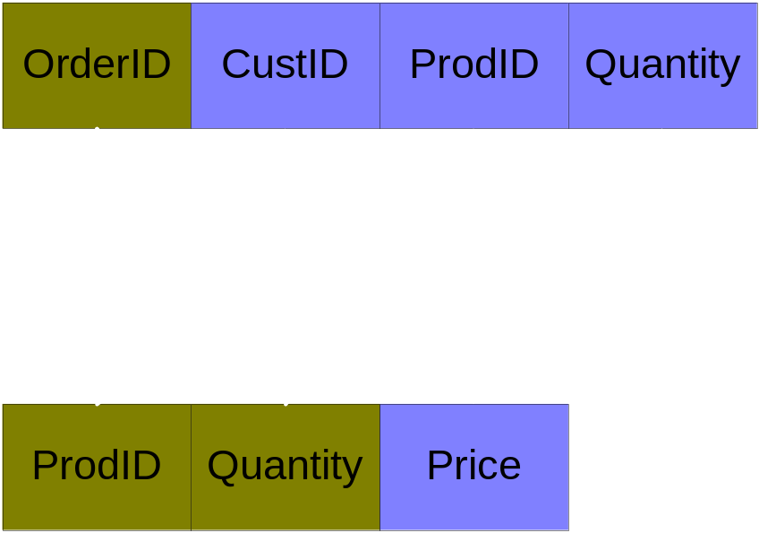
By splitting out the table, we can quickly adjust our price table to meet our competitor, or if the prices changes from our suppliers.

Slide 35
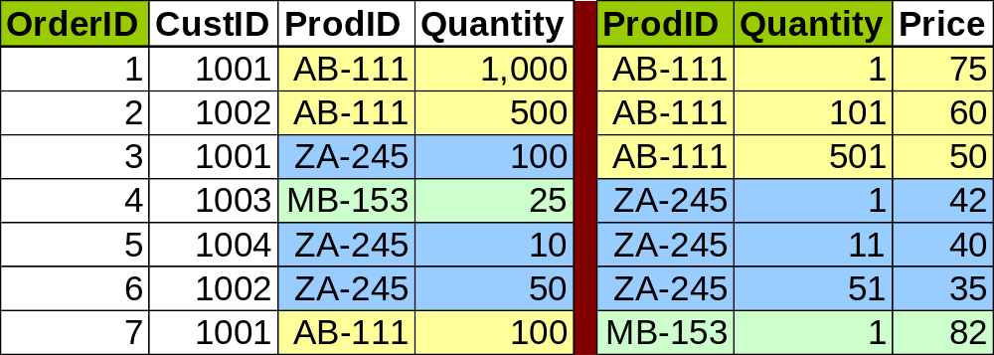
The second table is our pricing list.
Think of Quantity as a range:
  AB-111: 1-100, 101-500, 501 and more
  ZA-245: 1-10, 11-50, 51 and more
The primary Key for this second table is a composite of ProdID and Quantity.

Slide 36
Congratulations! We’re now in 3NF!
We can also quickly figure out what price to offer our customers for any quantity they want.

Slide 37
To Summarize (again)
A database is in 3NF if:
  It is in 2NF
  It has no transitive dependencies
    A transitive dependency exists when one attribute (or field) is determined by another non-key attribute (or field)
    We remove fields with a transitive dependency to a new table and link them by a foreign key.

Slide 38
Summarizing
A database is in 2NF if:
  It is in 1NF
  There is no repeating data in its tables.
    Put another way, if we use a composite primary key, then all attributes are dependent on all parts of the key.

Slide 39
And Finally…
A database is in 1NF if:
  All its attributes are atomic (meaning they contain only a single unit or type of data), and
  All rows have a unique primary key.

